Slide 1

VIT-FAQAssist Chatbot
Presented by - Mayank Gupta 20BCE1538
Guide - Dr. Geetha S.

Slide 2
What’s Chatbot?
A chatbot is a conversational agent that interacts with users using natural language.
Numerous applications of chatbots such as Customer Service, call centers etc
You must have used them once

Slide 3
NLU (Natura Language Understanding)
NLU helps the chatbot understand the query by breaking it down. We have used two specific concepts in building our college chatbot:
Entities: An entity represents keywords from the user’s query picked up by the chatbot to understand what the user wants. It is a concept in your chatbot. E.g., ‘Where is VIT’s Location?’ has the word ‘Location’ as an entity.
Intents: It helps identify the action the chatbot needs to perform on the user’s input. For instance, the intent of “Where is VIT” and “What is VIT Location? and “Where is VIT located” is the same. All of these user’s texts trigger a single command giving users options for t-shirts.
Numerous applications of chatbots such as Customer Service, call centers etc

Slide 4
NLU (Natura Language Processing)
Natural Language Processing (NLP) chatbot takes some steps to convert the customer’s text or speech into structured data to select the related answer. Some of the Natural Language Processing steps which we have used are
• Tokenization: The NLP divides a string of words into pieces or tokens. These tokens are linguistically symbolic or are differently helpful for the application.
• Named Entity Recognition: The chatbot program model looks for categories of words, like the name of the product, the user’s name or address, whichever data is required.
Like most applications, the chatbot is also connected to the database.

Slide 5


Objective
1.
Why need a contextual chatbot?
Address challenges faced by students living far from the college who visit only for specific purposes.
Improve information dissemination to prevent chaos like college reception during admission processing.
Reduces dependency on customer care & provides smooth navigation to users.
Help administrators analyze the students requirements and establish a connect with students.
FAQs are not served in an interactive manner.

Slide 6
15K+
VIT has around 15k+ Students only in Chennai Campus
That’s Huge
With the number only we can understand how hard it is for an administration to manage all of them.

Slide 7
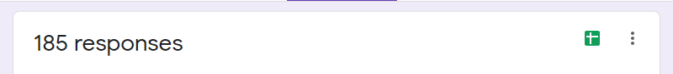
OUR STATs
60% of the students love to use more interactive way like chatbots.
11% via calls
27% via mobile applications etc.
2% want to go for meets.
AGE – 18 to 30
60%
want to use chatbot

Slide 8

VIT-FAQAssist
Business shift towards ChatBot
50% of businesses plan to spend more on chatbots than on mobile apps. 64% of internet users say 24-hour service is the best feature of chatbots. 37% of people use a customer service bot to get a quick answer in an emergency. There were over 300,000 chatbots on Facebook in 2018.
64%
37%
50%
VIT-FAQAssist

Slide 9
LITERATURE SURVEY
LITERATURE SURVEY
Author | Method Name | Advantages | Limitations | Analysis
[1] N. N. Khin and K. M. Soe | Seq2Seq Model with Attention | Effective Question Answering in Education | BLEU Score of 0.41 indicates potential accuracy challenges | Further exploration needed to understand limitations and areas for improvement
[2] L. T. Hien et al. | Adobot Approach | Interactive QA for Technical Support | Potential challenges in maintaining and updating ontology-based knowledge base | Long-term effectiveness of Adobot Approach needs investigation, especially in dynamic environments
[3] Eli Stevens, Luca Pietro Giovanni Antiga, Thomas Viehmann | PyTorch for Deep Learning | Engaging and user-friendly Python experience for deep learning | Potential challenges in scalability and integration with other frameworks | Consideration of project requirements and ecosystem compatibility is essential before choosing PyTorch
[4] M. Akhtar, J. Neidhardt, and H. Werthner | Chatbot Conversations Analysis | Insights into user interests and satisfaction | User engagement and satisfaction challenges identified | Deeper understanding of user expectations and proactive measures recommended
VIT-FAQAssist

Slide 10
LITERATURE SURVEY
LITERATURE SURVEY
[5] R. Vannala, S. B. Swathi, and Y. Puranam | AI Chatbot For Answering FAQ’s | Chatbot answers both textual and image-based queries | Challenges in accurately interpreting and responding to image-based queries | Thorough testing and validation required for image-based queries
[6] D. Singh, K. R. Suraksha, and S. J. Nirmala | Deep Learning with NLP for QA | Closed-domain QA system with deep learning and NLP | Difficulty in understanding diverse natural language questions | Further exploration needed for adaptability to evolving language nuances
[7] Prof. Nikita Hatwar, Ashwini Patil, Diksha Gondane | AI-based Chatbot | Utilizes Microsoft’s voice synthesizer | Challenges in achieving widespread adoption due to rapid evolution of voice tech | Continuous updates and integration with latest AI advancements recommended
[8] Rajasshrie Pillai, Brijesh Sivathanu | Adoption of AI-based Chatbots in Tourism | Factors influencing chatbot adoption in tourism | Challenges in implementing user-friendly and effective chatbots | Constant adaptation required for the dynamic tourism industry
[9] Martin Adam, Michael Wessel, Alexander Benlian | AI-based Chatbots in Customer Service | Investigates effects on user compliance using anthropomorphism | Demonstrates increased user compliance with anthropomorphic design cues | Initial step towards understanding AI-based CA effects in electronic markets and customer service
[10] Ulf Hermjakob | Parsing and Question Classification | Machine learning-based parsing and classification | Semantically enriched parse trees improve question parsing | Importance of semantically enriched treebanks for question answering applications
VIT-FAQAssist

Slide 11
Research Gap
1.
What we need in a contextual chatbot?
Limited data poses a challenge for training virtual assistant models.
Lack of comparative studies on intent recognition using deep learning frameworks.
Improved chatbots benefit from features like wide intent identification, quick response times, and user-reported error correction.
Framework performance impacts response time, accuracy, and scalability in chatbot development
Closing gaps can enhance chatbot capabilities, improving user interactions and query resolution

Slide 12
Problem Statement
1.
What we need in a contextual chatbot?
Offer features such as frequently asked questions, meeting students' and faculty's needs.
Creating a labeled knowledge base to train the chatbot using augmenting techniques.
Fast & easy integration with existing systems an API is created using FastAPI
Provide tools for administrators, including a chart dashboard and logging system, to analyze the bot's performance.
Ensure security with two-factor authentication and the CORS mechanism for protecting users' data are not served in an interactive manner.

Slide 13

Log In
Log off
DAILY ACTIVITY
Initialize the chat
Logged to Database
Authenticate
Output decided
Usery Query Input
Intent Recognized

Slide 14
Step 1
Chat with VITFAQAssist Bot sharing your query.
Step 3
The predicted intent will be matched with given set of answers in output.json
Step 2
Automated bot will tokenize the user-input and predict the intent using pytorch & tensorflow.
Step 4
One of the output for the intent will be chosen and will be sent as reply to the user query

Slide 15
Greetings
OTP Sent + Verified
FAQ
Send Email to admin
Instantly
Initialize
Main Page
Automatically get’s updated to database
History of FAQ
No
Fetch from Database
User Feedback
Yes
Send Email to admin
Instantly
Log Off

Slide 16
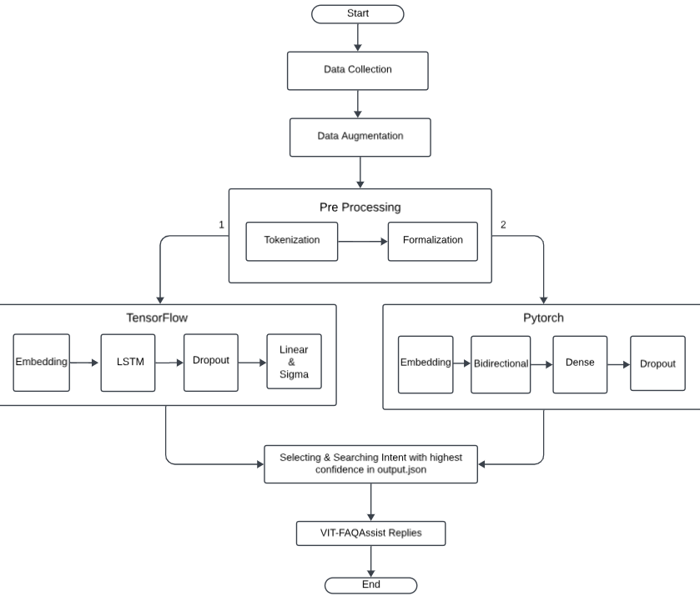
ARCHITECTURE

Slide 17
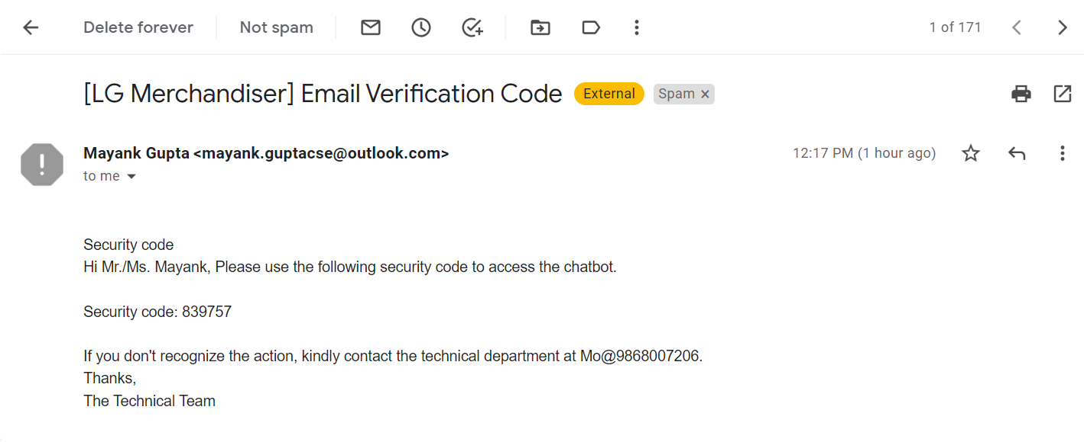
OTP AUTHENTICATION EMAIL SENT TO USER
Email sent to admin

Slide 18
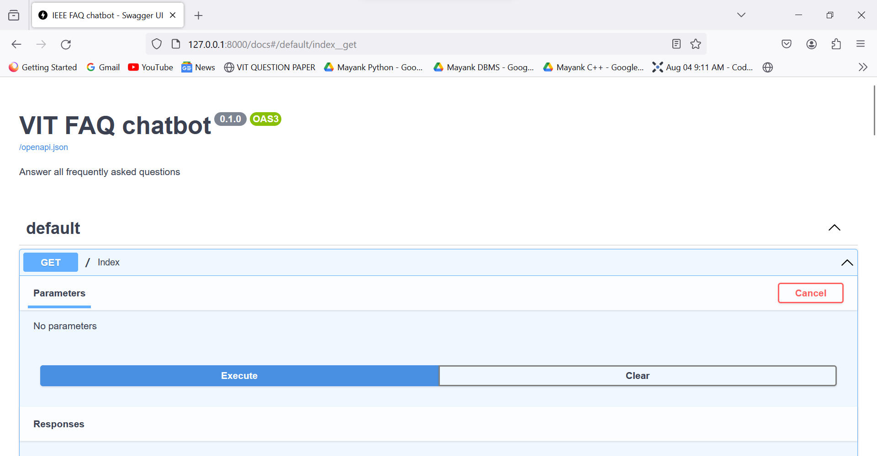
GET API CALL

Slide 19
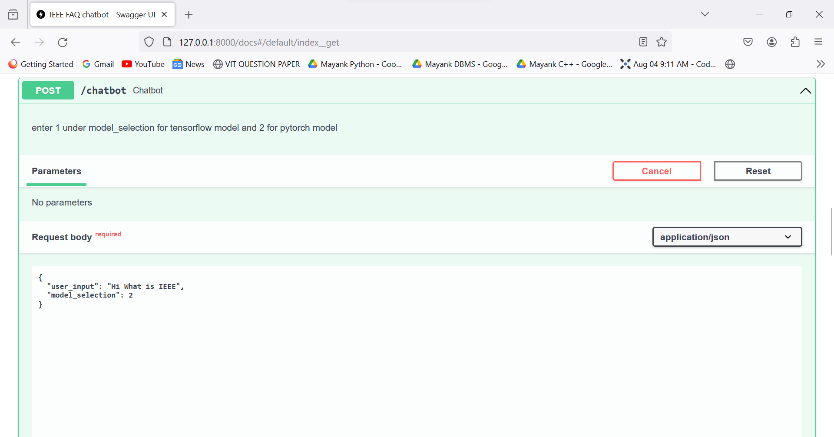
POST API CALL

Slide 20
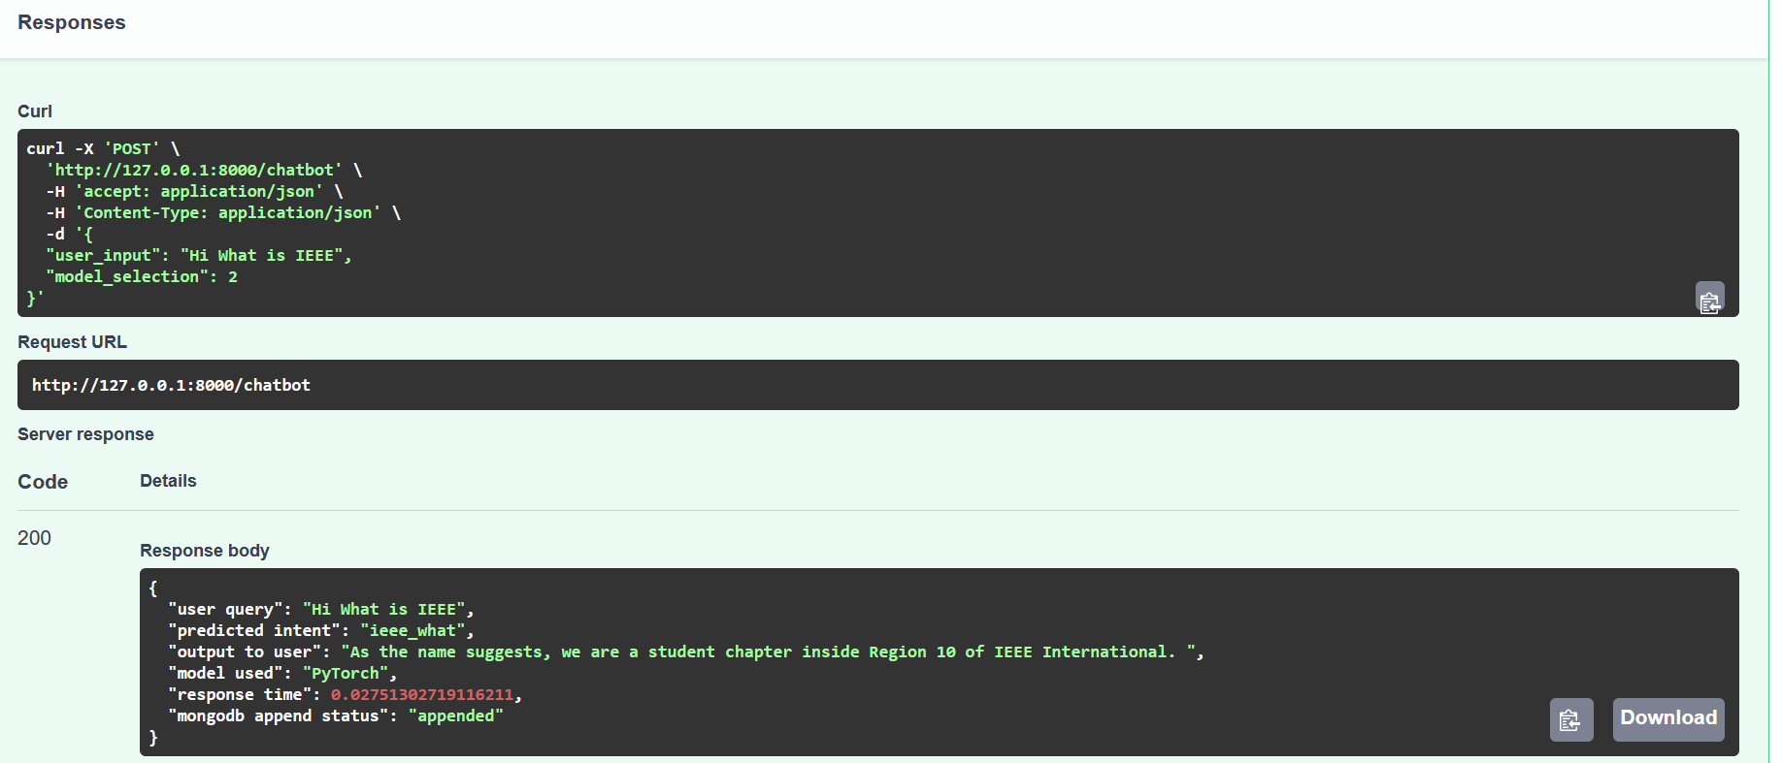
WORKING MODEL SCREEN SHOT

Slide 21
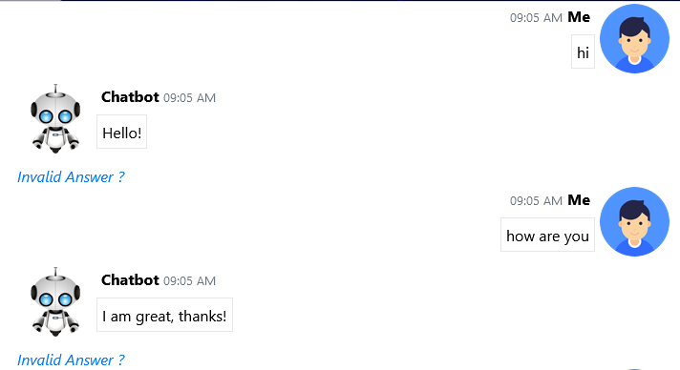
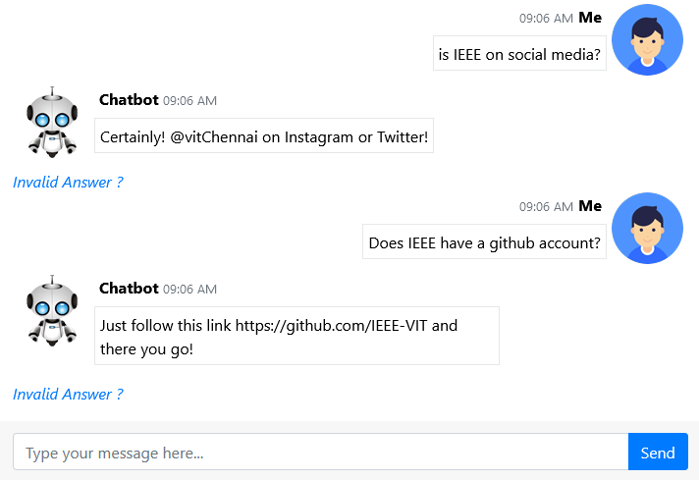
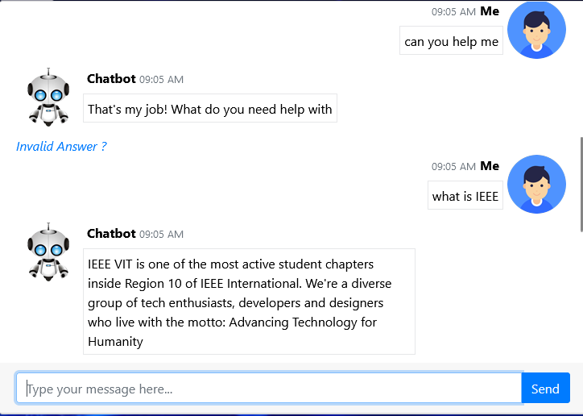
WORKING MODEL SCREEN SHOT

Slide 22
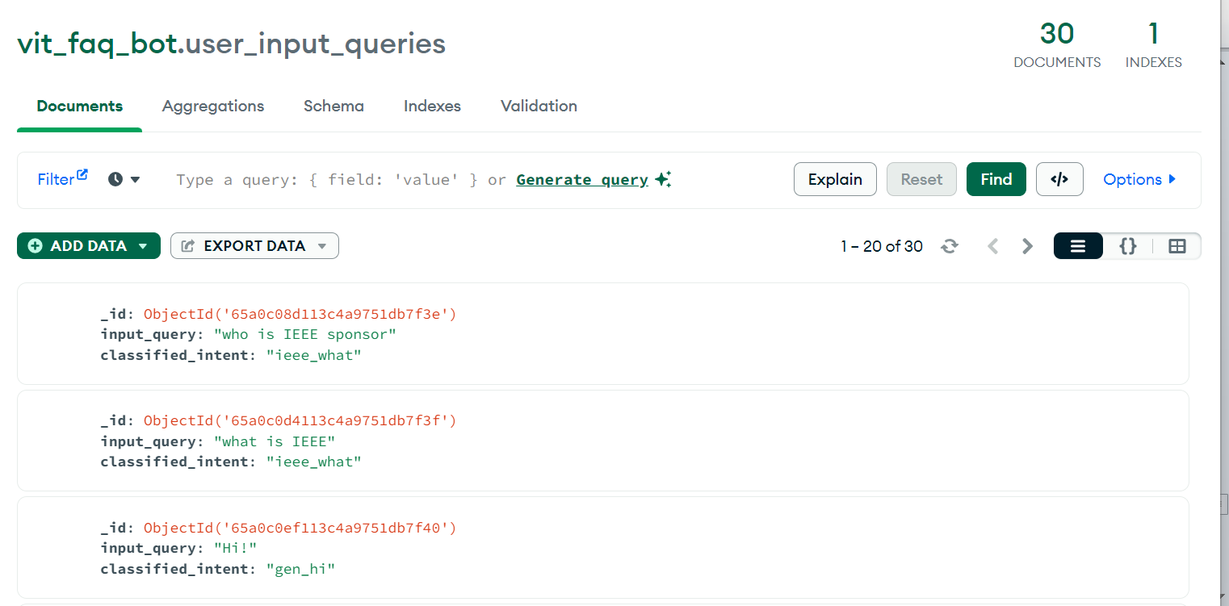
MongoDB connection SCREEN SHOT

Slide 23
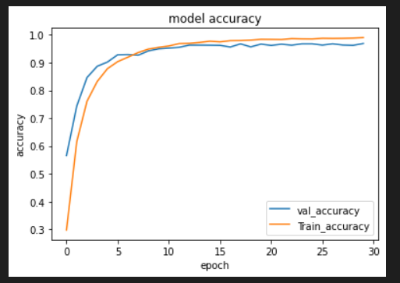
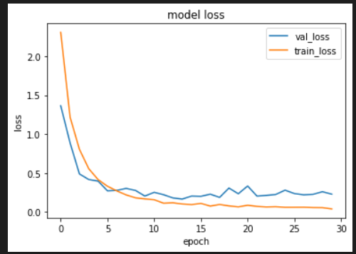
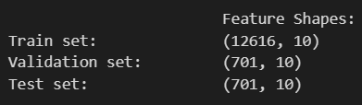
Model Graph
Accuracy Graph
Loss Graph

Slide 24
Evaluation Metrics Comparison
Evaluation Metrics | TensorFlow Framework | Pytorch Framework
Precision | 0. 9499 | 0.8889
Recall | 0. 9591 | 0.9778
F1 Score | 0.9494 | 0.9262
PyTorch has a greater recall, meaning it captures more positive occurrences but with somewhat lower accuracy, while the TensorFlow model has a higher precision and F1 score, showing better results in terms of precision-recall balance. Depending on the particular needs of the application, either precision or recall will be emphasised when choosing between each of the models.

Slide 25
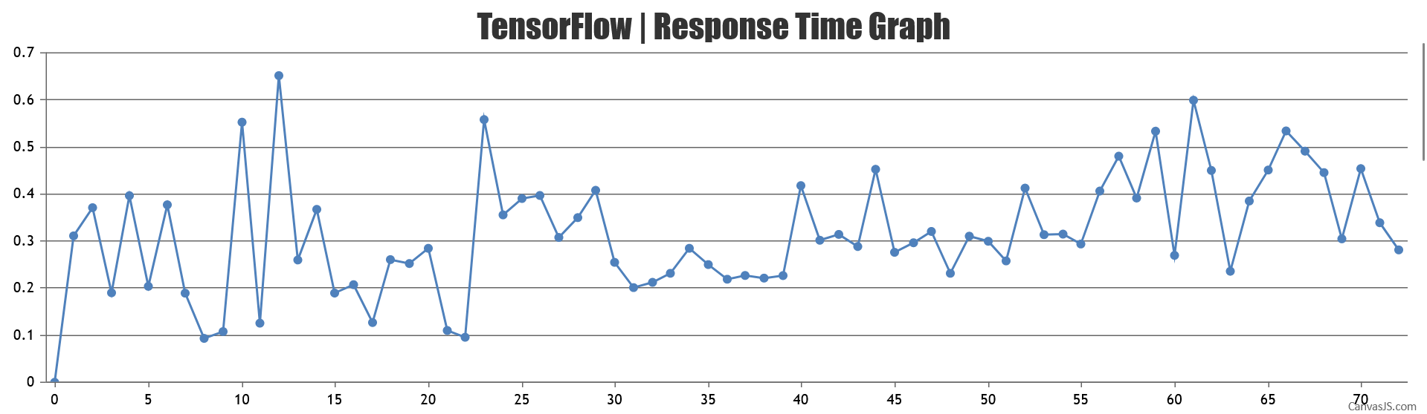
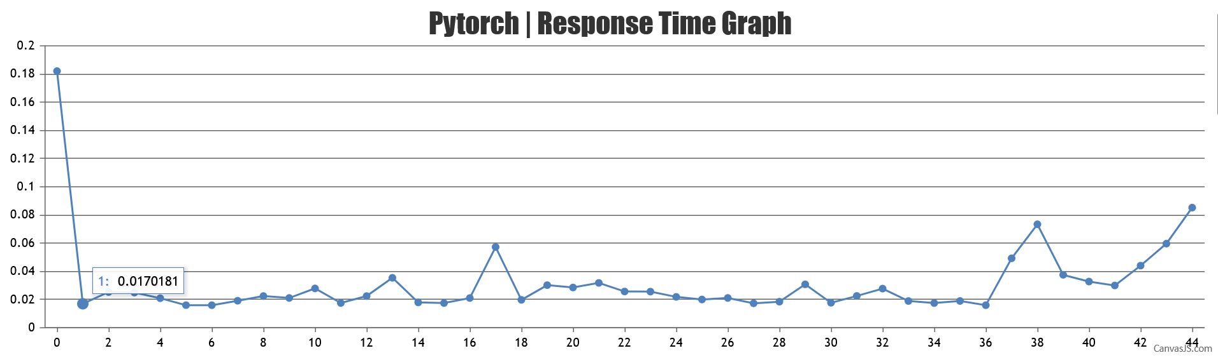
Response Time Graph
AVG – 0.246 Seconds
AVG – 0.02 Seconds
PyTorch outperformed the TensorFlow in terms of speed, with the latter responding slower on average

Slide 26
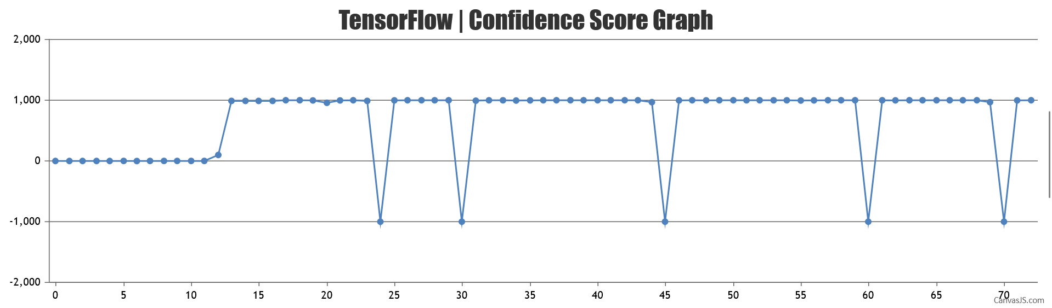
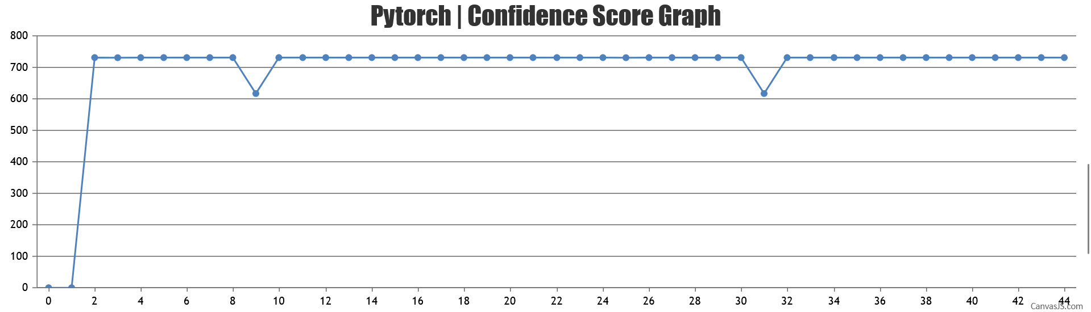
Confidence Score Graph
AVG – 98.9
AVG – 83.9
TensorFlow model is more effective in terms of confidence in predictions.

Slide 27
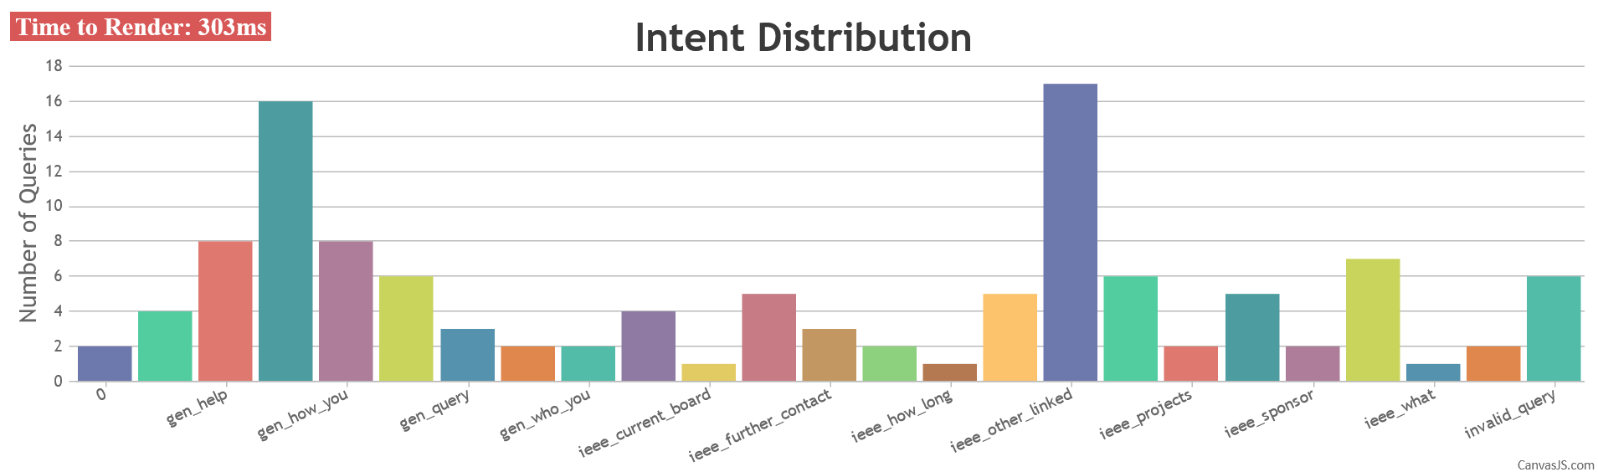
INTENT WISE DISTRIBUTION
The number of queries posed by a chatbot for each different objective is called “intent-wise distribution.

Slide 28
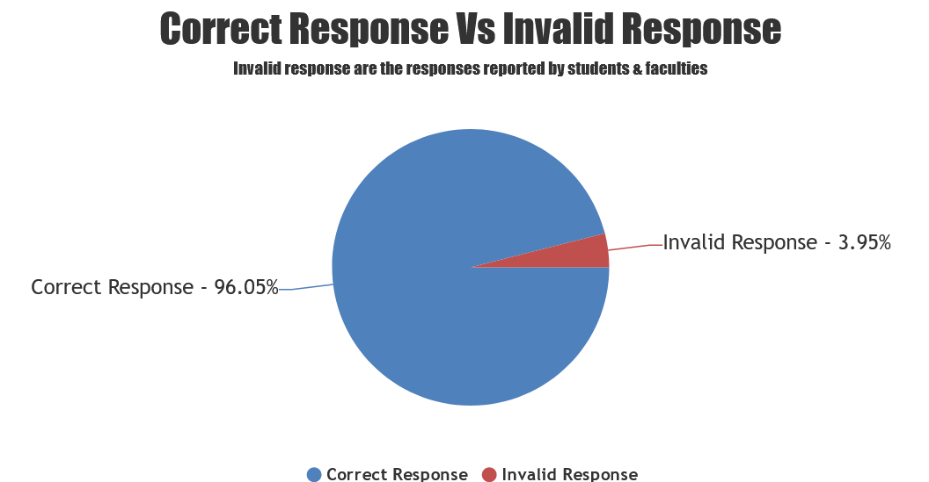
CORRECT RESPONSE VS INVALID RESPONSE
Only 3.95% of responses are marked as “invalid response” by teachers and students

Slide 29
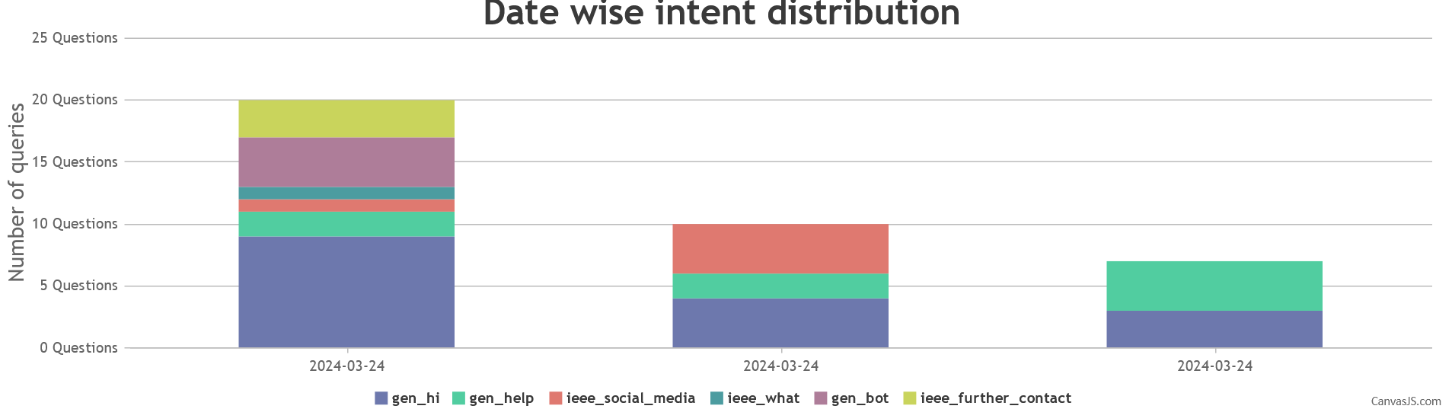
CORRECT RESPONSE VS INVALID RESPONSE
Examination of the distribution of user inquiries across time by various intents for each date

Slide 30

S
W
Efficiency & Speed
Initial Setup &
Training
The chatbot can quickly recognize and respond to student queries, providing instant assistance
Will train the students.
24/7 Availability
It operates round the clock, providing students with support outside regular office hours.
Natural Language
We can train our bot to understand the natural language of the user.
Using Machine Learning model
Cost Efficiency
Continuous Improvement
O
Security & Privacy concern
Multiple Number of users can be added
T
Integration with Other Services
With exposure over internet ,
Recurring Cost
Same application can run over different channels Eg. MSTeams,
Wechat, Email …
A small but recurring amount of Funds paid to azure.

Slide 31
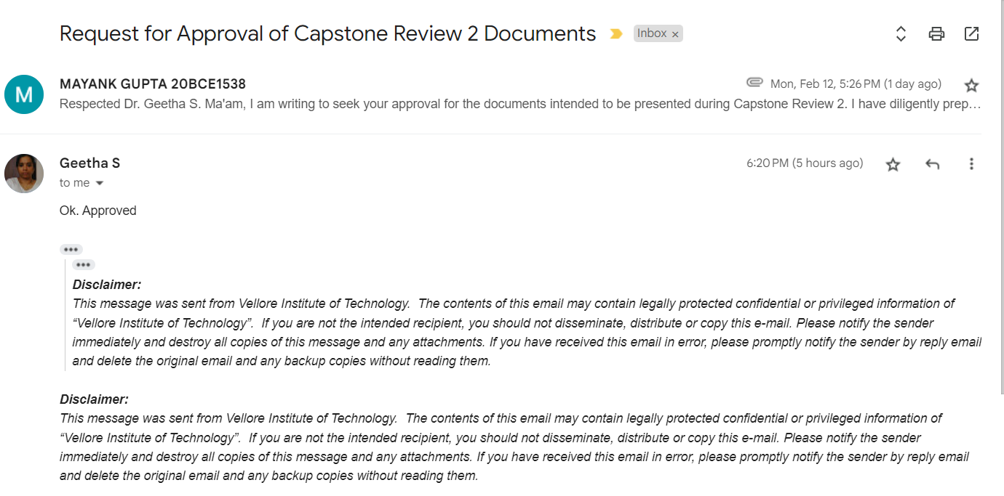
CONFERENCE/JOURNAL SUBMISSION PROOF

Slide 32
REVIEW 3 DOCUMENT GUIDE APPROVAL

Slide 33
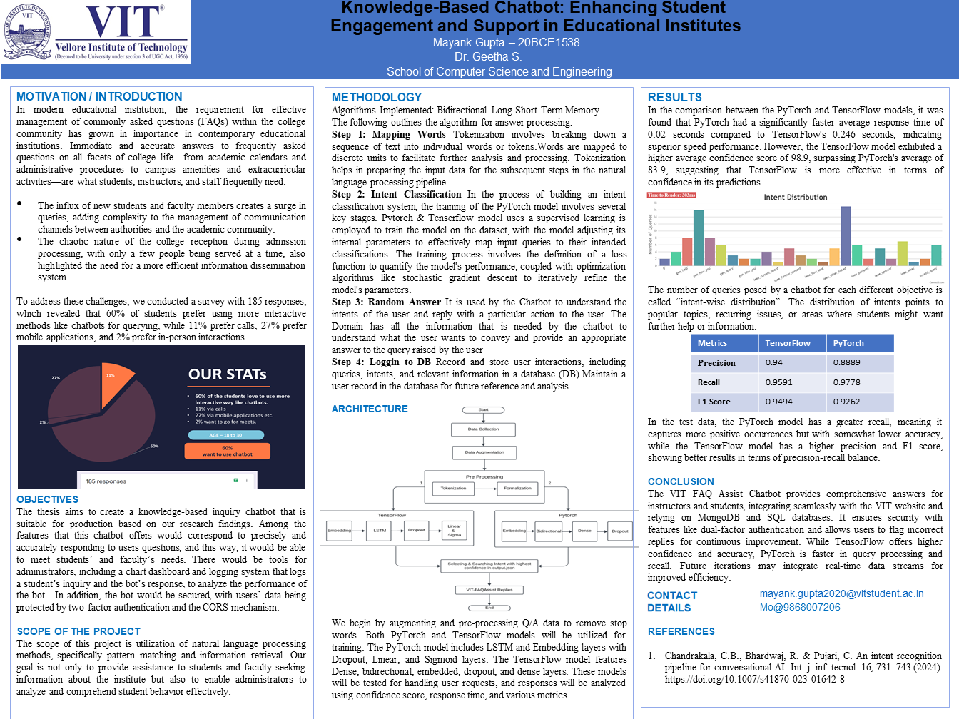

Slide 34

YOU HELD THROUGH !
Thank you!
Prepared by:
Mayank Gupta
20BCE1538 – 4th Yr B.Tech CSE @ VIT CHENNAI

Slide 35
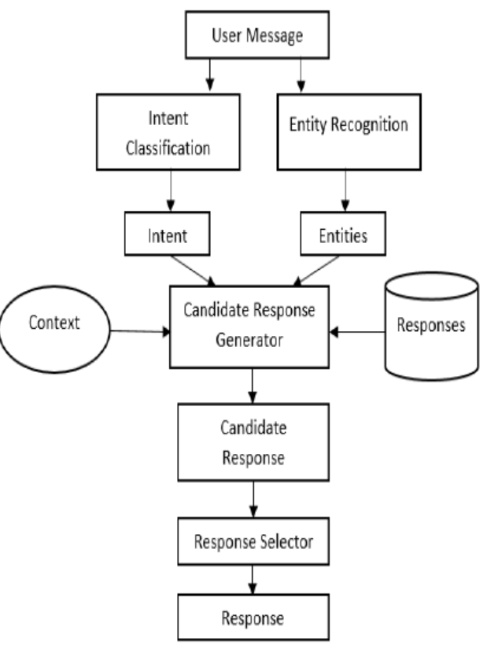
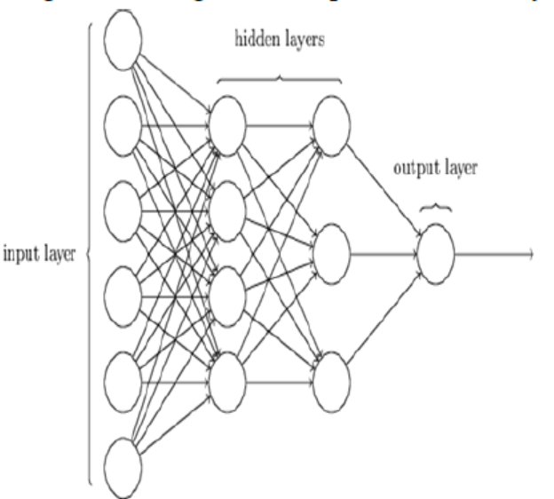

Slide 36
One-hot Vector Representation
I love coffee.
I like dogs.
Vocab {I, love, coffee, I, like, dogs}
Integers assigned
I: 0, love: 1, coffee: 2, like: 3, dogs: 4
Vector representations:
I: [1,0,0,0,0]
love: [0,1,0,0,0]
coffee: [0,0,1,0,0]
like: [0,0,0,1,0]
dogs: [0,0,0,0,1]

Slide 37
Review 2 PPT Approval

Slide 38

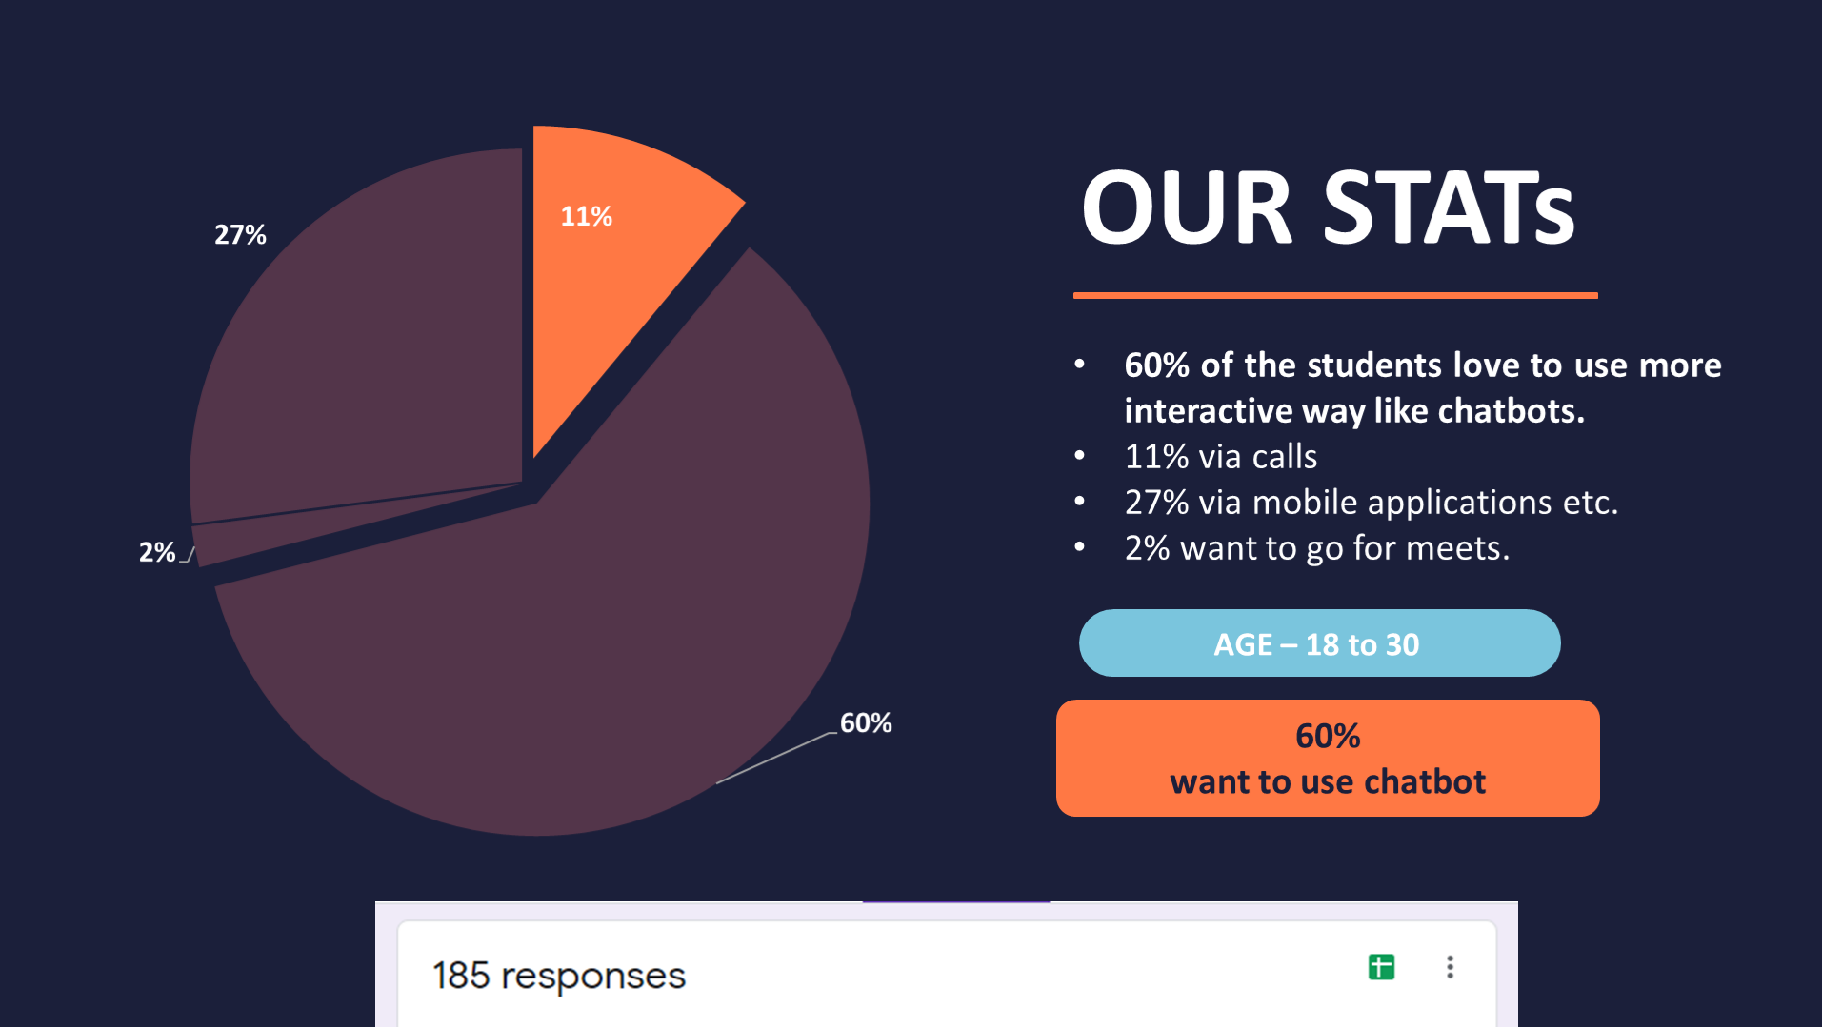

Knowledge-Based Chatbot: Enhancing Student
Engagement and Support in Educational Institutes
Mayank Gupta – 20BCE1538
Dr. Geetha S.
School of Computer Science and Engineering
MOTIVATION / INTRODUCTION
In modern educational institution, the requirement for effective management of commonly asked questions (FAQs) within the college community has grown in importance in contemporary educational institutions. Immediate and accurate answers to frequently asked questions on all facets of college life—from academic calendars and administrative procedures to campus amenities and extracurricular activities—are what students, instructors, and staff frequently need.
The influx of new students and faculty members creates a surge in queries, adding complexity to the management of communication channels between authorities and the academic community.
The chaotic nature of the college reception during admission processing, with only a few people being served at a time, also highlighted the need for a more efficient information dissemination system.
To address these challenges, we conducted a survey with 185 responses, which revealed that 60% of students prefer using more interactive methods like chatbots for querying, while 11% prefer calls, 27% prefer mobile applications, and 2% prefer in-person interactions.
OBJECTIVES
The thesis aims to create a knowledge-based inquiry chatbot that is suitable for production based on our research findings. Among the features that this chatbot offers would correspond to precisely and accurately responding to users questions, and this way, it would be able to meet students’ and faculty’s needs. There would be tools for administrators, including a chart dashboard and logging system that logs a student’s inquiry and the bot’s response, to analyze the performance of the bot . In addition, the bot would be secured, with users’ data being protected by two-factor authentication and the CORS mechanism.
SCOPE OF THE PROJECT
The scope of this project is utilization of natural language processing methods, specifically pattern matching and information retrieval. Our goal is not only to provide assistance to students and faculty seeking information about the institute but also to enable administrators to analyze and comprehend student behavior effectively.
METHODOLOGY
Algorithms Implemented: Bidirectional Long Short-Term Memory
The following outlines the algorithm for answer processing:
Step 1: Mapping Words Tokenization involves breaking down a sequence of text into individual words or tokens.Words are mapped to discrete units to facilitate further analysis and processing. Tokenization helps in preparing the input data for the subsequent steps in the natural language processing pipeline.
Step 2: Intent Classification In the process of building an intent classification system, the training of the PyTorch model involves several key stages. Pytorch & Tenserflow model uses a supervised learning is employed to train the model on the dataset, with the model adjusting its internal parameters to effectively map input queries to their intended classifications. The training process involves the definition of a loss function to quantify the model's performance, coupled with optimization algorithms like stochastic gradient descent to iteratively refine the model's parameters.
Step 3: Random Answer It is used by the Chatbot to understand the intents of the user and reply with a particular action to the user. The Domain has all the information that is needed by the chatbot to understand what the user wants to convey and provide an appropriate answer to the query raised by the user
Step 4: Loggin to DB Record and store user interactions, including queries, intents, and relevant information in a database (DB).Maintain a user record in the database for future reference and analysis.
ARCHITECTURE
We begin by augmenting and pre-processing Q/A data to remove stop words. Both PyTorch and TensorFlow models will be utilized for training. The PyTorch model includes LSTM and Embedding layers with Dropout, Linear, and Sigmoid layers. The TensorFlow model features Dense, bidirectional, embedded, dropout, and dense layers. These models will be tested for handling user requests, and responses will be analyzed using confidence score, response time, and various metrics
RESULTS
In the comparison between the PyTorch and TensorFlow models, it was found that PyTorch had a significantly faster average response time of 0.02 seconds compared to TensorFlow's 0.246 seconds, indicating superior speed performance. However, the TensorFlow model exhibited a higher average confidence score of 98.9, surpassing PyTorch's average of 83.9, suggesting that TensorFlow is more effective in terms of confidence in its predictions.
The number of queries posed by a chatbot for each different objective is called “intent-wise distribution”. The distribution of intents points to popular topics, recurring issues, or areas where students might want further help or information.
In the test data, the PyTorch model has a greater recall, meaning it captures more positive occurrences but with somewhat lower accuracy, while the TensorFlow model has a higher precision and F1 score, showing better results in terms of precision-recall balance.
CONCLUSION
The VIT FAQ Assist Chatbot provides comprehensive answers for instructors and students, integrating seamlessly with the VIT website and relying on MongoDB and SQL databases. It ensures security with features like dual-factor authentication and allows users to flag incorrect replies for continuous improvement. While TensorFlow offers higher confidence and accuracy, PyTorch is faster in query processing and recall. Future iterations may integrate real-time data streams for improved efficiency.
mayank.gupta2020@vitstudent.ac.in
Mo@9868007206
REFERENCES
Chandrakala, C.B., Bhardwaj, R. & Pujari, C. An intent recognition pipeline for conversational AI. Int. j. inf. tecnol. 16, 731–743 (2024). https://doi.org/10.1007/s41870-023-01642-8
Metrics | TensorFlow | PyTorch
Precision | 0.94 | 0.8889
Recall | 0.9591 | 0.9778
F1 Score | 0.9494 | 0.9262

Slide 40
Chatbot
1.
Why need a contextual chatbot?
Chatbots are a necessary part of good user experience.
Reduces dependency on customer care & provides smooth navigation to users
On conventional web apps, users have to go to a dedicated FAQ section to get info organized under key categories.
FAQs are not served in an interactive manner
No user context is used to narrow down FAQs & show relevant ones

Slide 41
Problem Statement
VITQuickFAQ is your swift and reliable companion for navigating the frequently asked questions at VIT Chennai. Designed for efficiency, this chatbot streamlines the process of obtaining accurate and timely information. Whether you're seeking details about admissions, course structures, or campus services, VITQuickFAQ is here to provide instant and concise answers
Our Chatbot will be designed for the merchandisers to :
* Student user login & register.
* Browse categories & products• Place, view or cancel orders.
* Frequently Asked Questions(FAQ) answering chatbot, customly built to answer any question related to IEEE-VIT .
* Further, an API is created for the same using FastAPI.
Key Features of the Product :
* Instant Response with automatic time-to-time pop-up(alerts).
* Assist managing team with easy to keep track functionality
* Work Stress Busters with clear & timely reporting.
* Automating Business Operations for Visible Efficiency Gains due to fast communication.
--> Say goodbye to lengthy searches and welcome the quick, hassle-free assistance of VITQuickFAQ – your go-to guide for all things VIT Chennai.
7
Notes:
Food loss and waste reduction should be seen as a means toward achieving other objectives, including improving food security and nutrition, reducing greenhouse gas emissions, lowering pressure on water and land resources and can increase productivity and economic growth. The formulation of effective policies toward food loss and waste reduction requires comprehensive information as to how much and where – both geographically and along the supply chain – various foods are lost or wasted. FAO’s work on measurement and support to countries to take action to reduce food loss and waste is critical to tracking progress made by countries..

Slide 42
RESEARCH GAP
LITERATURE SURVEY
In the realm of chatbots and deep learning, two critical research gaps persist. Firstly, training deep learning models for virtual assistants with limited data poses a significant challenge. An Assistant require substantial amounts of data for effective learning, yet obtaining such volumes of labeled data can be arduous. To circumvent this limitation, we have used augmentation techniques to artificially expand the dataset, enhancing the model's ability to generalize and respond accurately to a variety of inputs. Secondly , the research gap in chatbots and deep learning includes lack of research on intent recognition using different deep learning frameworks, conducting comparative analyses on the performance of deep learning frameworks for chatbot development is crucial. Each framework has its strengths and weaknesses, impacting factors like response time, accuracy, and scalability. Understanding how these frameworks fare against each other can provide valuable insights for developers seeking to build more efficient and effective chatbot systems. Closing these research gaps could lead to more robust and adaptable chatbots, capable of handling diverse user queries with accuracy and efficiency.
VIT-FAQAssist

